Slide 1
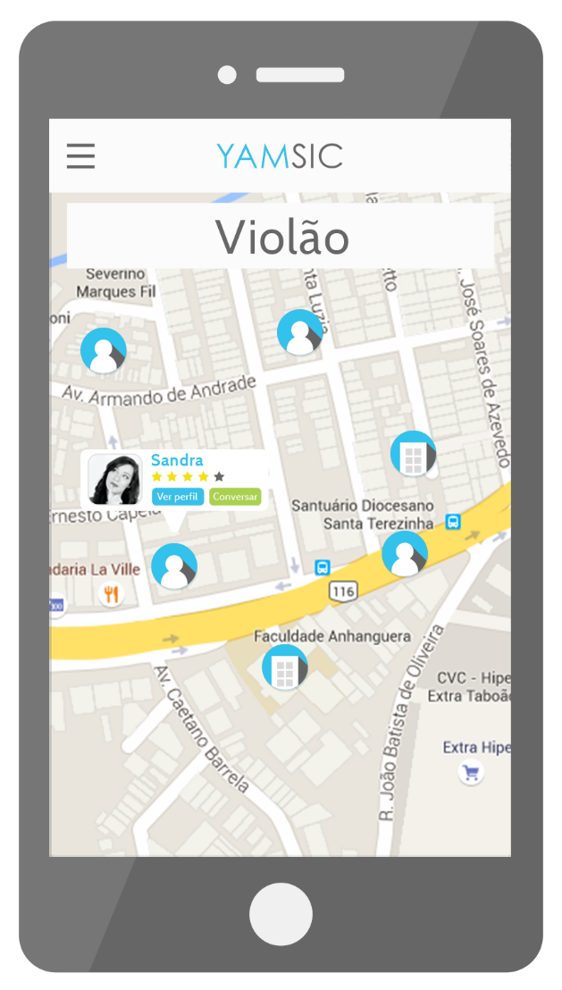


Slide 2



THE PAIN
No place for students to look at for music teacher
recommendations.
It’s hard for private music teachers to find new students.
Trust is a very important factor to consider when
searching for private classes.

Slide 3

THE SOLUTION
Introducing…
The only music education platform where you can find
the perfect network to start music classes!

Slide 4


THE MUSIC EDUCATIONAL PLATFORM
It all starts by downloading the app on the marketplaces.
Once you’ve downloaded, sign up to fill your profile.
Then you search for the name of one or more
instruments that you want to learn or teach.
And that’s it! Find a lot of cool people who’s
already teaching or learning the instrument!

Slide 5





HOW IT WORKS?
Set filters to refine
your search such as
location or skills.
Find the most
recommended and the
new folks’ profiles.
Log in to see the
full profiles and
start meeting people.
Schedule your
classes and start
learning or teaching!
Rate your class
experience on the
platform.
Receive shiny rewards
as you make progress
and recommend!

Slide 6




THE MARKET
* Source: SEBRAE. December 2015.
Education corresponds to 11% of
the music industry size in Brazil, one
of the top three major sectors. *
High level of informality thus not
having reliable information to
precisely measure the market. *
Lack of technical and professional
education, as well as innovation
on the business models. *
Lack of internal controls, marketing
and finance tools and information
systems. *

Slide 7



MARKET FIT
* Source: Agência Senado. March 2016.
People looking for their first time job as a music teacher.
Comply with the Brazilian law 13.278/2016, that requires
public schools to have music classes. *
Students that want to teach in order to help finance their
studies.

Slide 8



EXISTING SOLUTIONS
Musician social networks.
Facebook groups.
Word of mouth.
Music schools.

Slide 9





HOW TO MAKE MONEY?
* In app currency.
Percentage on each
transaction made on
the platform.
Advertising for teachers
and partners.
Buy note coins* to
unlock gamification
content.
Fee to recover your
status in case you lose
your class sequence.
Premium subscription
to access your full class
history and comparison.
Music tests to prove
abilities and get more
recommendations.

Slide 10


WHAT DO WE NEED?
At least one developer on the team.
Mentoring on entrepreneurship for startups.

Slide 12

MEET THE YAMERS!
Henrique
Esdras
Leilaane / Felipe
UX Designer
Marketing
Comercial

